Slide 1
Pre-Health Research Journal Club
June 5th, 2020

Slide 2
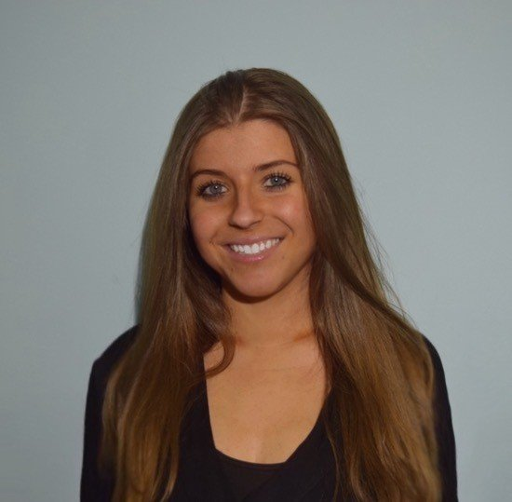
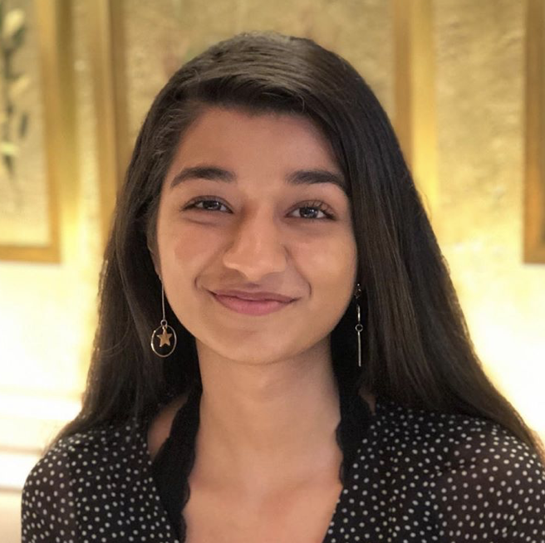
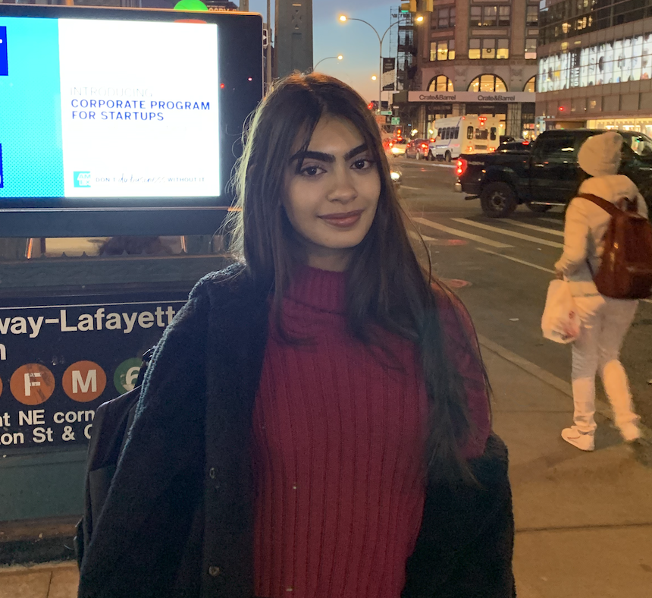

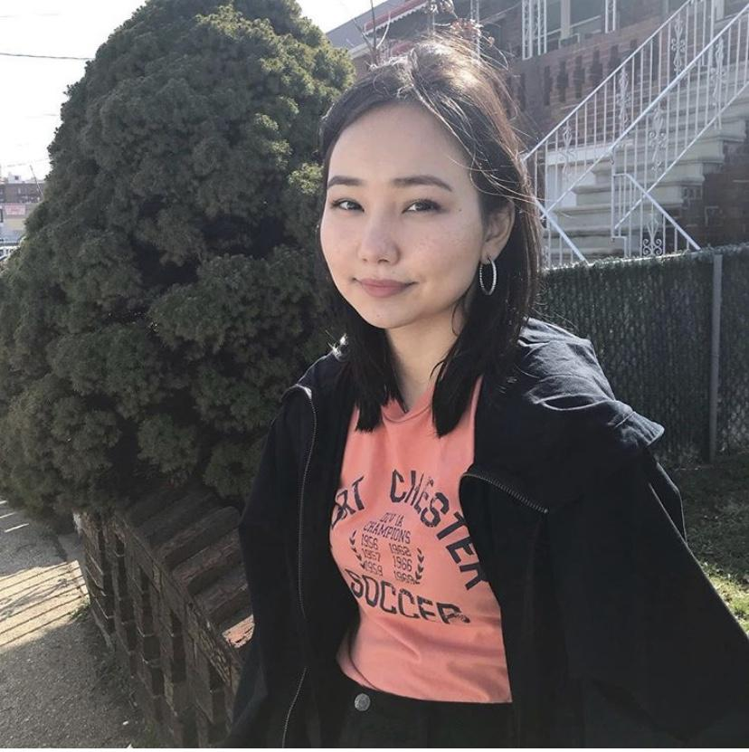
FOUNDERS/MENTORS
Natalya
Krutovska
Deepshikha
Kewlani
Mahnoor Memon
Zaina
Syed
Alia Isabekova

Slide 3

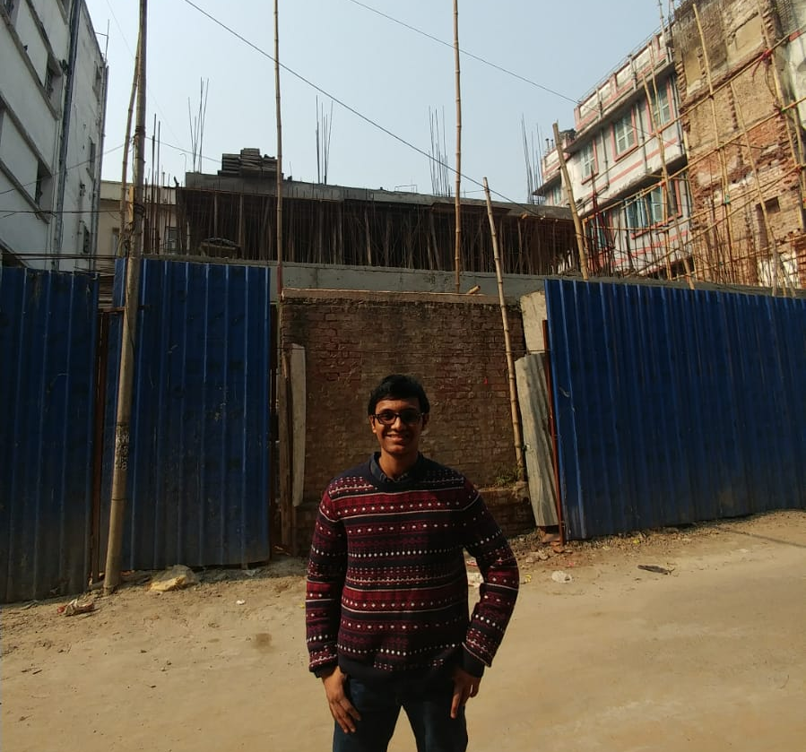
Special Speakers
Srinjoy
Goswami
Jamilia
Isabekova
Fourth Year Medical Student at SUNY Downstate
Junior Yalow Scholar at Hunter. Lab Assistant/Research Weill Cornell Medicine

Slide 4

About Us
The Pre-Health Research Journal Club is an interdisciplinary
student-run club at Hunter College.
Bimonthly Fridays from 12pm to 2pm
Our Mission
Provide a platform for students that are interested in discussing and presenting research that has been published in scientific journals.
Improve critical literature interpretation skills and discuss controversies amongst the field of research and medicine. Students will better understand how results of studies can be applied in clinical practice.
Provide mentorship to students who are interested in presenting and provide resources for students who are seeking a lab position.
Substitute the loss of opportunities during Summer 2020. Help students to
continue building their resumes and aid in building essential skills
that can be applied in scientific investigation.

Slide 5
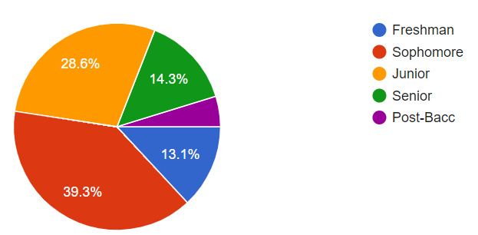
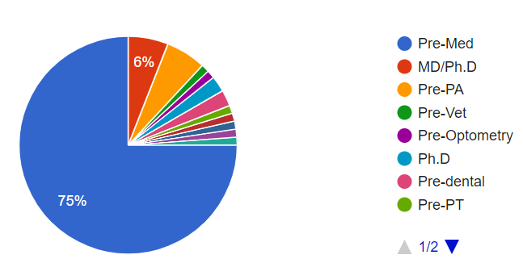
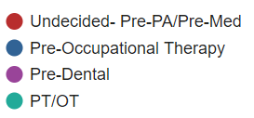
About You!
*statistics limited to members who have already signed up
Research Backgrounds
Weill Cornell Medicine | Memorial Sloan Kettering (SCORE)
Hospital of Special Surgery | Biology and Chemistry Labs at Hunter
CUNY Institutions | All Laboratory Classes
Icahn School of Medicine at Mount Sinai | No Research Experience
New York University (SURP) | Hunter Research Journal Club!

Slide 6
AGENDA
Speaker Series
Mini Workshop
Journal Club and Discussion
Immunotherapy for Skin Cancer
~Jamilia Isabekova~
~Srinjoy Goswami~
~Club guidelines for students interested in presenting~
~Resources~

Slide 7
Timeline of Meeting
12:00 Intro!
12:10 Journal Club (Immunotherapy for Skin Cancer)
12:25 Journal Club Discussion
12:50 Jamilia Presentation (4th Year Medical Student)
1:00 Jamilia Q & A
1:10 Srinjoy Presentation (Junior at Hunter w/ 6 years of research experience)
1:25 Srinjoy Q & A
1:40 Mini Workshop (Guidelines for future presentations, available resources, etc)
1:45 Presentation Form/Interest form/ Confirming Attendance/ Q & A
(Also found in comment section)

Slide 8
Immunotherapy for Skin Cancer

Slide 9
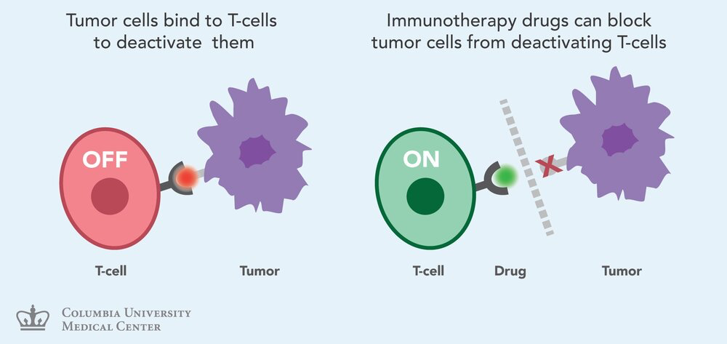
Background Vocabulary
T-Cell
Immunotherapy
Antigen
Malignant
Metastatic

Slide 10
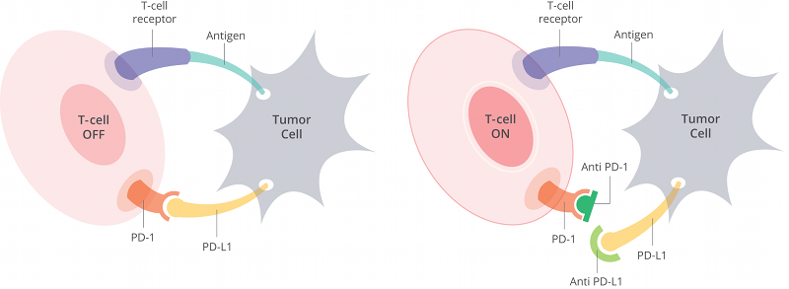
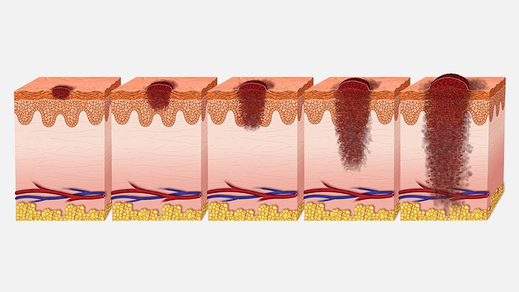
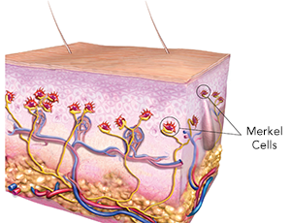
Key Terms
Cutaneous Malignancy
Immune Checkpoint
Melanoma
Merkel Cell
PD-1

Slide 11
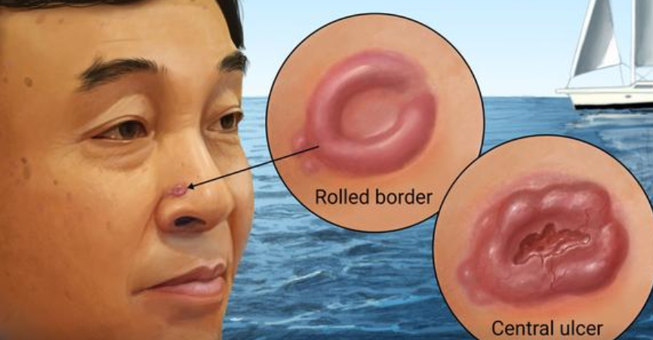
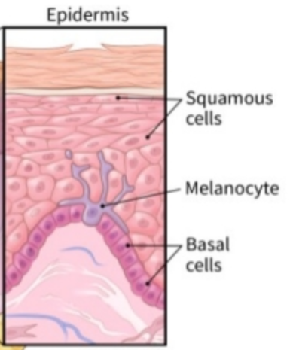
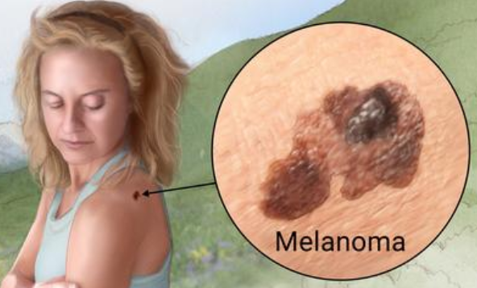
Skin Cancer Classification
Basal Cell Carcinoma
Non-Melanoma Skin Cancer
Cutaneous Malignant Melanoma (MM)
Other
Basal Cell Carcinoma (BCC)
Squamous cell carcinoma (cSCC)
Malignant Melanoma
Merkel Cell Carcinoma (MCC)
Malignant Melanoma

Slide 12
Main Topics
Skin cancer
Public health concern
Sixth most common cancer in USA
3-year overall survival for metastatic melanoma has improved 5-fold due to success of immunotherapy
Reasons for the immunogenicity of skin cancers
History of immunotherapy for melanoma
Improvements, shortcomings, and complications of immunotherapy with skin cancer
Mechanisms behind resistance to immunotherapy
Primary and adaptive resistance

Slide 13
Immunogenicity of Skin Cancer
T-cell Immunosuppression
Reversing the ability of tumors to evade the immune system is the goal of immunotherapy
Tumor Mutation Burdens - epitopes
Virus-positive skin cancers - antigens
Triggering recognition of tumors with cellular therapy that affects epitopes or antigens would be enough to create an immune reaction against tumors

Slide 14
Progress with Immunotherapy
Melanoma - 2% of all skin cancer cases, but the greatest contributor to skin cancer deaths
1880s- injections of killed bacteria
1970s- high dose of Bacillus Calmette Guerin (BCG) at tumor sites
Cytokine therapy- short term benefits of less than 5 years
2015- modified herpes virus
Response rate of 26%
Greatest success: Immune checkpoint inhibitors
Response rate of 40-45%

Slide 15
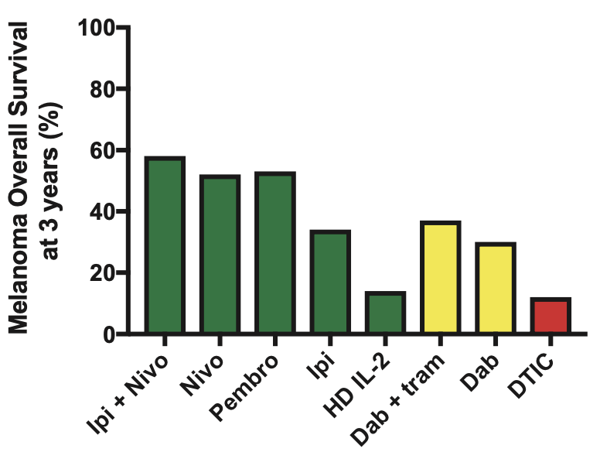
Potential for the immune system to cure metastatic solid tumors
In most cases targeted therapies do not result in cures.
Large number of cancer cells upon diagnosis.
Adaptive immune system can engage with tumors.
There is an increase in survival of 2-3 years with ongoing responses and treatment .
The chart on the right explains the survival rate in regards to different therapies.
Red shows chemotherapy
Yellow shows targeted therapy
Green shows immune therapy

Slide 16
Treatment of a low-tumor burden may be associated with improved outcomes
Immunotherapy applied after the initial treatment improved melanoma specific and overall survival.
The smaller the tumor , the more responsive it is to immunotherapy.
2 possible explanations for why immunotherapy might be effective in some cases and not others.
The bigger the tumor the bigger the chance of the tumor being resistant.
Larger tumors are more likely to be resistant due to the lack and presence of molecules that act as both chemical and physical barriers to T-cell function.
Currently, performing surgical resection before immunotherapy is recommended.
Application of anti-PD-1 to other skin tumors
Inhibition of PD-1/ PD-L1 inhibitors were attempted on other skin cancers and is still in the works.
PD-1 : programmed cell death proteins.
High response rate.

Slide 17
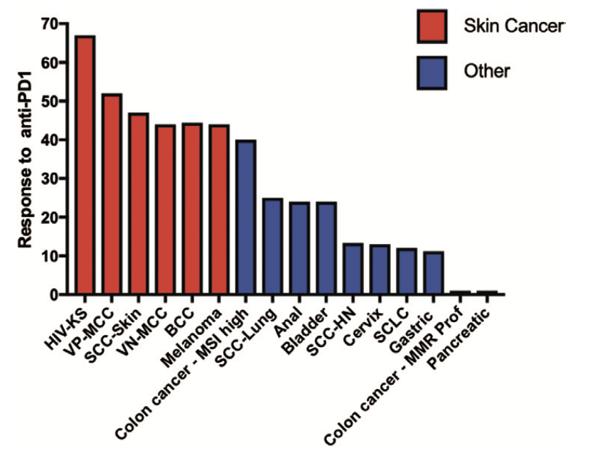
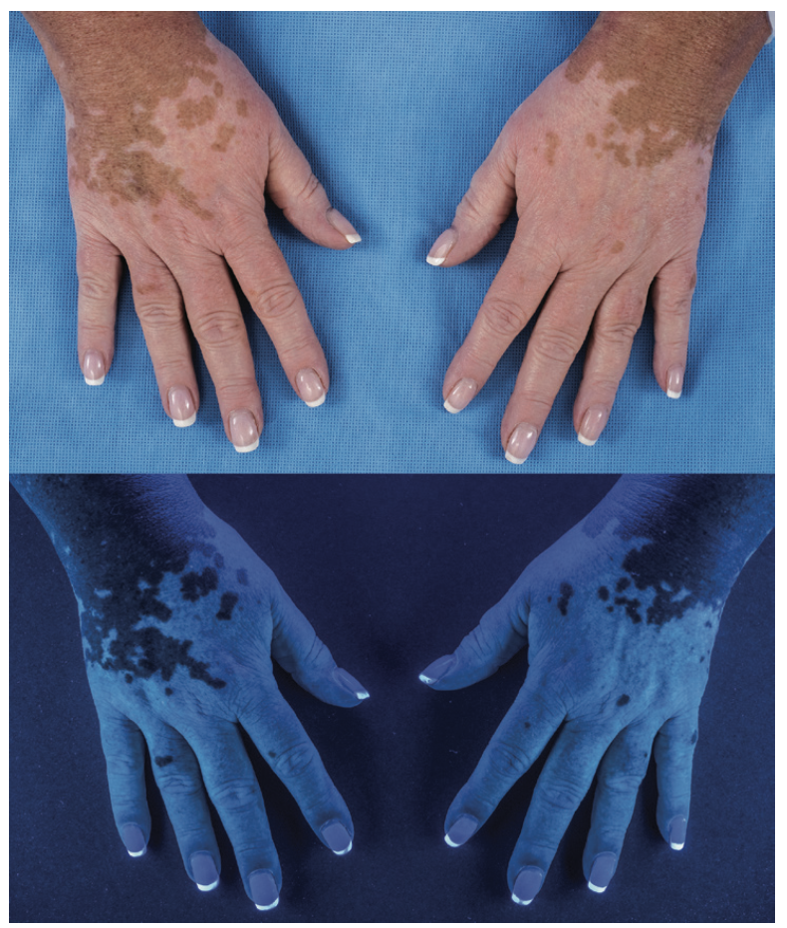
Skin toxicities of checkpoint inhibitors immunotherapy
Immune checkpoints are influenced by immune-related adverse events.
Related to autoimmune attacks.
Inhibitors for skin cancer appear similar to malignant tumors.
Immune-Related Adverse Events can affect other organ systems.
Cutaneous - Endocrine -Pulmonary
Gastrointestinal Tract - Nervous
-Trials of anti-PD 1 agents in skin cancer and non skin cancers.
Cutaneous immune related adverse events lead to
Rashes - Lichenoid
Eczema - Erythrodermic
Psoriatic - Hypopigmentation
Vitiligo

Slide 18
Current Understanding of Mechanisms
How resistance to immunotherapy arises
Responsiveness and resistance to immune checkpoint blockade* and immunotherapy cannot be predicted by a single biomarker. TMB is not enough.
Tumor cell-intrinsic factors:
Antigens
Antigen Presentation***
Tumor Metabolism***
Microenvironment Factors
Macrophages
Fibroblasts
Dendritic Cells and Langerhans cell
Endothelial Cells
NK Cells
Immune Checkpoint Blockade: prevents the termination of immune responses

Slide 19
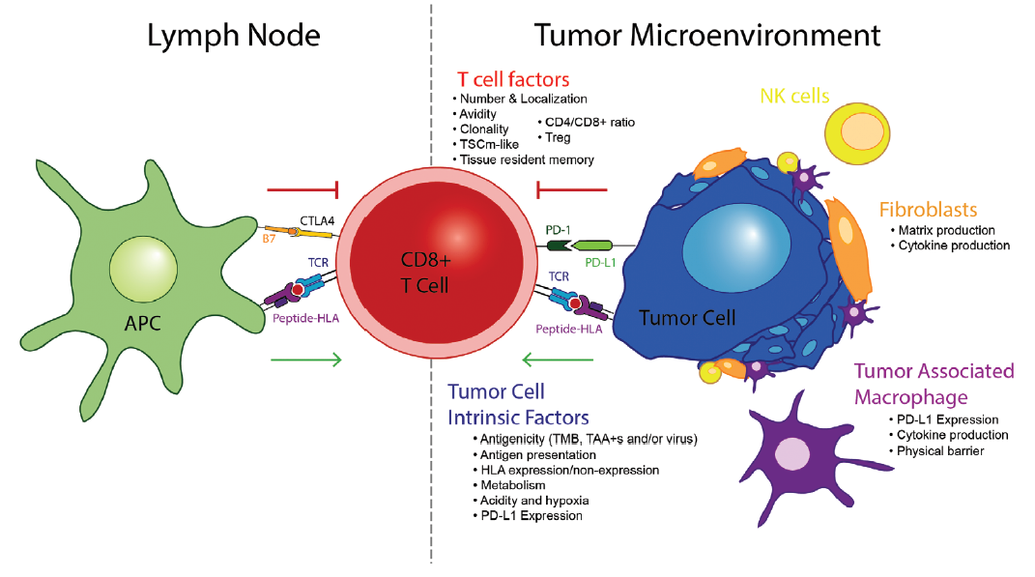
Immune Checkpoint
Predicting antigen presentation
Cytotoxic
T Cell
Antigen Presenting Cell

Slide 20
Immune Checkpoint
Predicting antigen presentation
Cytotoxic
T Cell
Antigen Presenting Cell

Slide 21
Immune Checkpoint
Predicting antigen presentation
Cytotoxic
T Cell
Antigen Presenting Cell

Slide 22
Immune Checkpoint
Predicting antigen presentation
Cytotoxic
T Cell
Antigen Presenting Cell

Slide 23
Working towards...
Overcoming barriers in the efficacy of immunotherapy which is delineated by tumor cell-intrinsic, T cell and microenvironment obstacles.

Slide 24

CONCLUSION
The research journal focuses on the progress of immunotherapy for skin cancers and it reviews different mechanisms of resistance to immunotherapy.
The research found that skin cancers are highly immunogenic due to the presence of tumor-associated antigens, mutations, and/or viral gene expression.
Melanoma is used as the typical example of a solid tumor for the development of immunotherapy.
Research with melanoma suggests the potential for the immune system to cure solid tumors.

Slide 25

Using the research found with melanoma, other skin cancers have been found to be treated successfully with anti-PD-1 inhibitors.
Unfortunately not all patients are treated completely with these treatments due to barriers that disrupt the efficacy of immunotherapy.
Research regarding these barriers is still ongoing.

Slide 26
Citations
Kelly G Paulson, Miranda C Lahman, Aude G Chapuis, Isaac Brownell, Immunotherapy for skin cancer, International Immunology, Volume 31, Issue 7, July 2019, Pages 465–475
https://doi.org/10.1093/intimm/dxz012

Slide 27
Discussion

Slide 28
Jamilia Isabekova
Hunter graduate (2015); 4th Year Medical Student at SUNY Downstate

Slide 29


Working in A Research Laboratory as an Undergraduate Student
How to get in, make the most of the experience, and what you can do during COVID-19
Hunter College Pre-Health Journal Club
06/05/2020
Srinjoy Goswami
Research Volunteer: Guzman Laboratory Weill Cornell Medicine
Laboratory Assistant: Hematology/Oncology Department Weill Cornell Medicine
Junior Yalow Scholar Undergraduate Student: City University of New York Hunter College

Slide 30
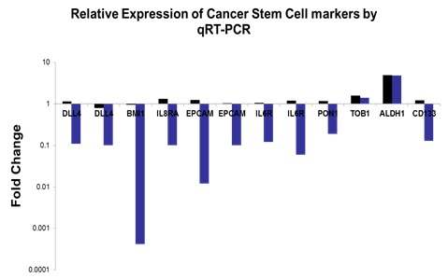
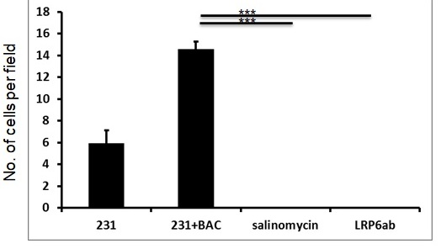
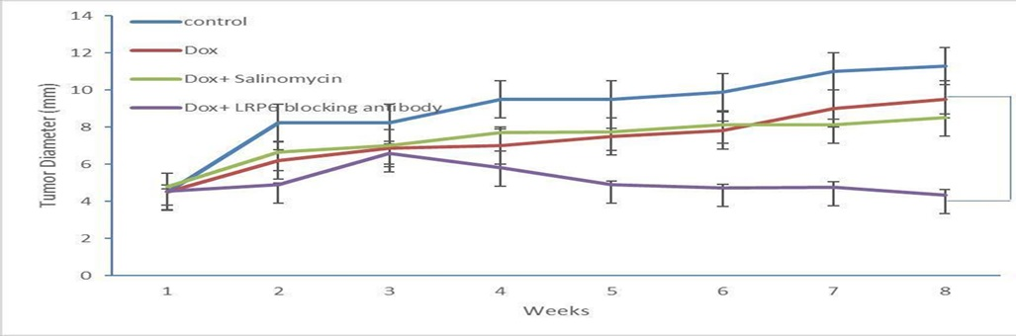
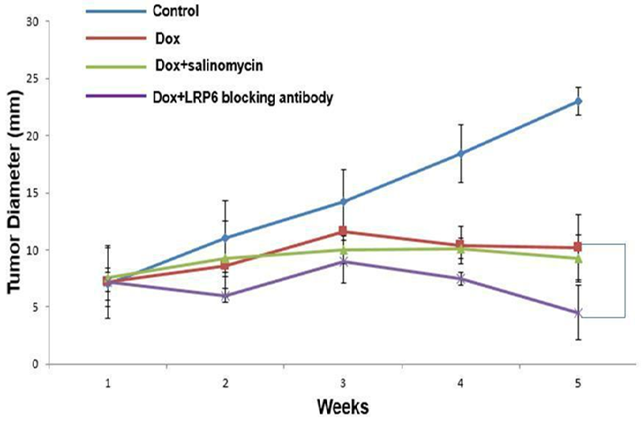
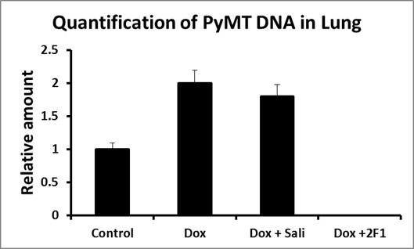
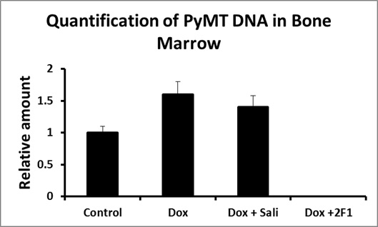
BACKGROUND IN RESEARCH: ALBERT EINSTEIN COLLEGE OF MEDICINE UNDER DR. SUMANTA GOSWAMI
Most significant project focused on:
WNT Signaling Pathway Involvement in Breast Cancer Stem Cells and Metastasis
Contributes to Tumor Microenvironment enrichment of Breast Cancer Stem Cells (BCSCs)
Identification of BSCS that help in process of intravasation
With WNT inhibitors intravasation was inhibited in intravasation assay.
PyMT primer quantification data used to determine level of metastasis in FvB mice
For SCID GAPDH showed similar result
Primary tumor size decreased as well.
Wnt Pathway and intravasation linkage shown
Development of an intravasation score.
Inhibition of transendothelial migration by wnt inhibitors: We performed Transendothelial migration using 231 cells and BACs and inhibited the same with Salinomycin and LRP6 antibody N=6, p<0.001. Error bars correspond to standard error
Cancer cells capable of transendothelial migration have a gene expression signature like breast cancer stem cells: We performed Transendothelial migration using 231 cells and BACs ans separated the cancer cells and performed qRT-PCR on them

Slide 31

BACKGROUND IN RESEARCH: WEILL CORNELL MEDICINE UNDER DR. MONICA GUZMAN
Projects Focused around:
Role Leukemia Stem Cells (LSCs) in Acute Myeloid Leukemia and therapeutic methods to target
Targeting of CLL-1 in Leukemia Stem Cells
CAR-T cells used to target CLL-1
Several treatment methods showed success in elimination of CLL-1 positive LSCs
Role of Ferroportin and Iron-nanoparticle drugs on LSCs.
Downregulation of Ferroprotein in LSCs
Iron-overload eliminates LSCs
Working to better understand the mechanism
Develop more efficient/effective methods for treatment.

Slide 32
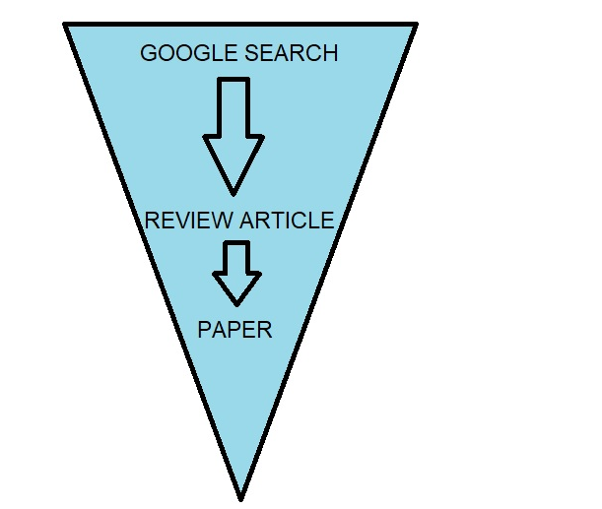
UNDERSTANDING A PAPER AND REVIEW ARTICLE VERSUS PAPER
Key Points to Understand:
Research starts a broad knowledge base (Google, Wiki)
Go to Review article
Distinguished by lack of traditional structure
Review article has broader range of understanding vs Journal article
Good starting point for understanding research, new updates in general sense
Read most recent papers.
TAKE NOTES!

Slide 33
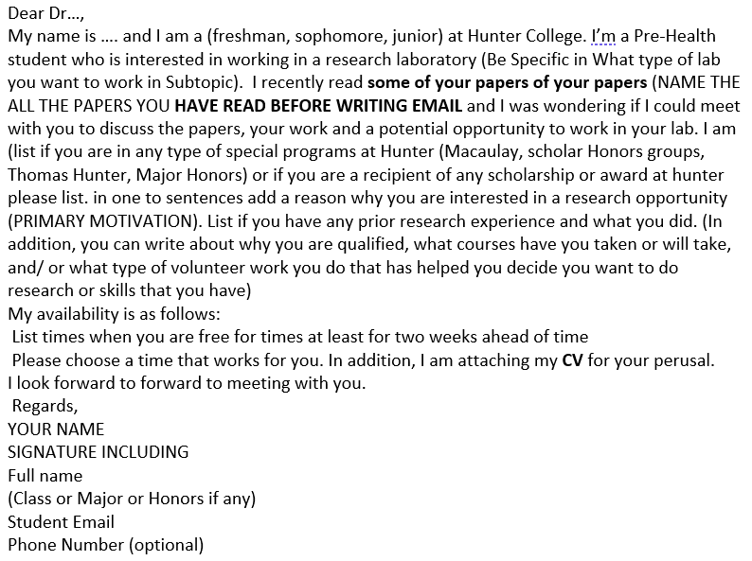
EMAILING A PI: HOW TO GO ABOUT IT
Things to Include:
Make sure email is short and concise and Professional
Market Yourself with relevant information and skills
CV prepared
EMAIL FROM HUNTER ACCOUNT!
Mention the papers with “Names” you have read
Flexible Interview Dates: 2 weeks
Follow up emails
Do not get discouraged if PI rejects or doesn’t reply.

Slide 34
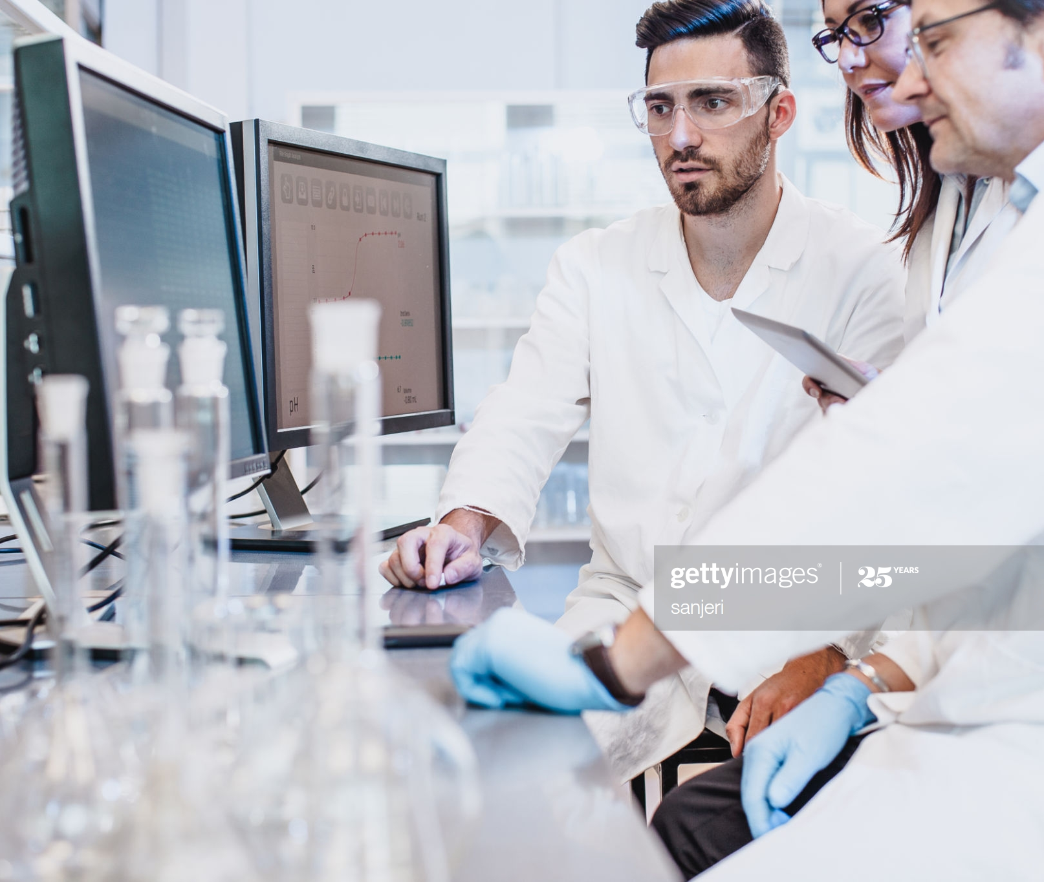
INTERVIEWING AND LATER WORKING WITH PI: WHAT TO DO AND WHAT NOT TO DO
Make sure to:
Be Professional (attire, addressing)
Show interest and understanding
Bring your notes!
HAVE QUESTIONS!!!
Pen and Paper
Be available to talk
Be ENGAGED!! (Keep yourself busy and Productive)
Learn for your mistakes

Slide 35



RESEARCH RELATED THINGS TO DO DURING COVID-19 PANDEMIC
Literature Review and finding PI’s:
Read different papers from different PI’s (local)
Narrow down your interests
Identify a list of PI’s you would like to work with
Pre-Health Listserv and Major Listserv
Research Programs (MD-PhD or PhD)
Look at Hunter and Beyond

Slide 36


RESEARCH RELATED THINGS TO DO DURING COVID-19 PANDEMIC
Learn Research Methods:
Understanding Science behind Research is just one part
The techniques and why they are used matter as well.
Several Courses from Biotech companies and MOOC
Learn about Flow Cytometry from BD
General Methods course from Coursera
Will help in lessening the learning curve in labs.

Slide 37




RESEARCH RELATED THINGS TO DO DURING COVID-19 PANDEMIC
Understand Statistics and Intro to Bioinformatics:
Basic Statistics knowledge from YouTube (Use Excel for applying)
Learn R and MATLAB
Knowledge of R and MATLAB can help in using different Bioinformatics concepts
SPSS, GraphPad PRISM
Bash and Python for further knowledge

Slide 38


RESEARCH RELATED THINGS TO DO DURING COVID-19 PANDEMIC
Learn to use different Databases
PI’s use these databases everyday
Apply the skills learned from R and MATLAB
Data mining and making correlations can lead to papers
NCBI Blast is a good beginner program to start
cBIoportal allows for R and MatLab integration
Molsoft is a chemistry database meant for data visualization.

Slide 39

HUNTER COLLEGE RESEARCH DATABASE DEVELOPMENT
We want to have a database of labs, for you to want look at and find labs that you are interested in
If you are currently working in a lab:
Email if there are any open positions or PI is looking for volunteers
Hunter and Elsewhere
Clinical Research Opportunities also accepted
Email all required materials
Email items to: Srinjoy.Goswami37@myhunter.cuny.edu
or srinjoygoswami@gmail.com

Slide 40
ACKNOWLEDGMENTS
I would like to thank the following:
Dr. Goswami and the Goswami Lab
Dr. Guzman and the Guzman Lab
Ms. Kemile Jackson
Jamilia Isabekova
The Founders of The Pre-health Research Journal Club:
Natalya Krutovska, Deepshikha Kewlani, Mahnoor Memon, Zaina Syed, and Alia Isabekova

Slide 41
Interested in Becoming a Journal Club Presenter?
To be qualified to present you must attend at least 2 prior meetings.
Students are welcome to present alone or in a group (up to 5 people).
Solo and group presenters will be notified of their presentation date within a week of their submission.
3 Presentations/Discussions per meeting + Workshops/ Speaker Series (varied)
Student Presentation Series Dates:
Friday, June 19th, 2020
Friday, July 3rd, 2020
Friday, July 17th, 2020
Friday, July 31st, 2020
Friday, August 14th, 2020
Interest Form:
https://forms.gle/B4uPZDeUhtQG3GFq8

Slide 42
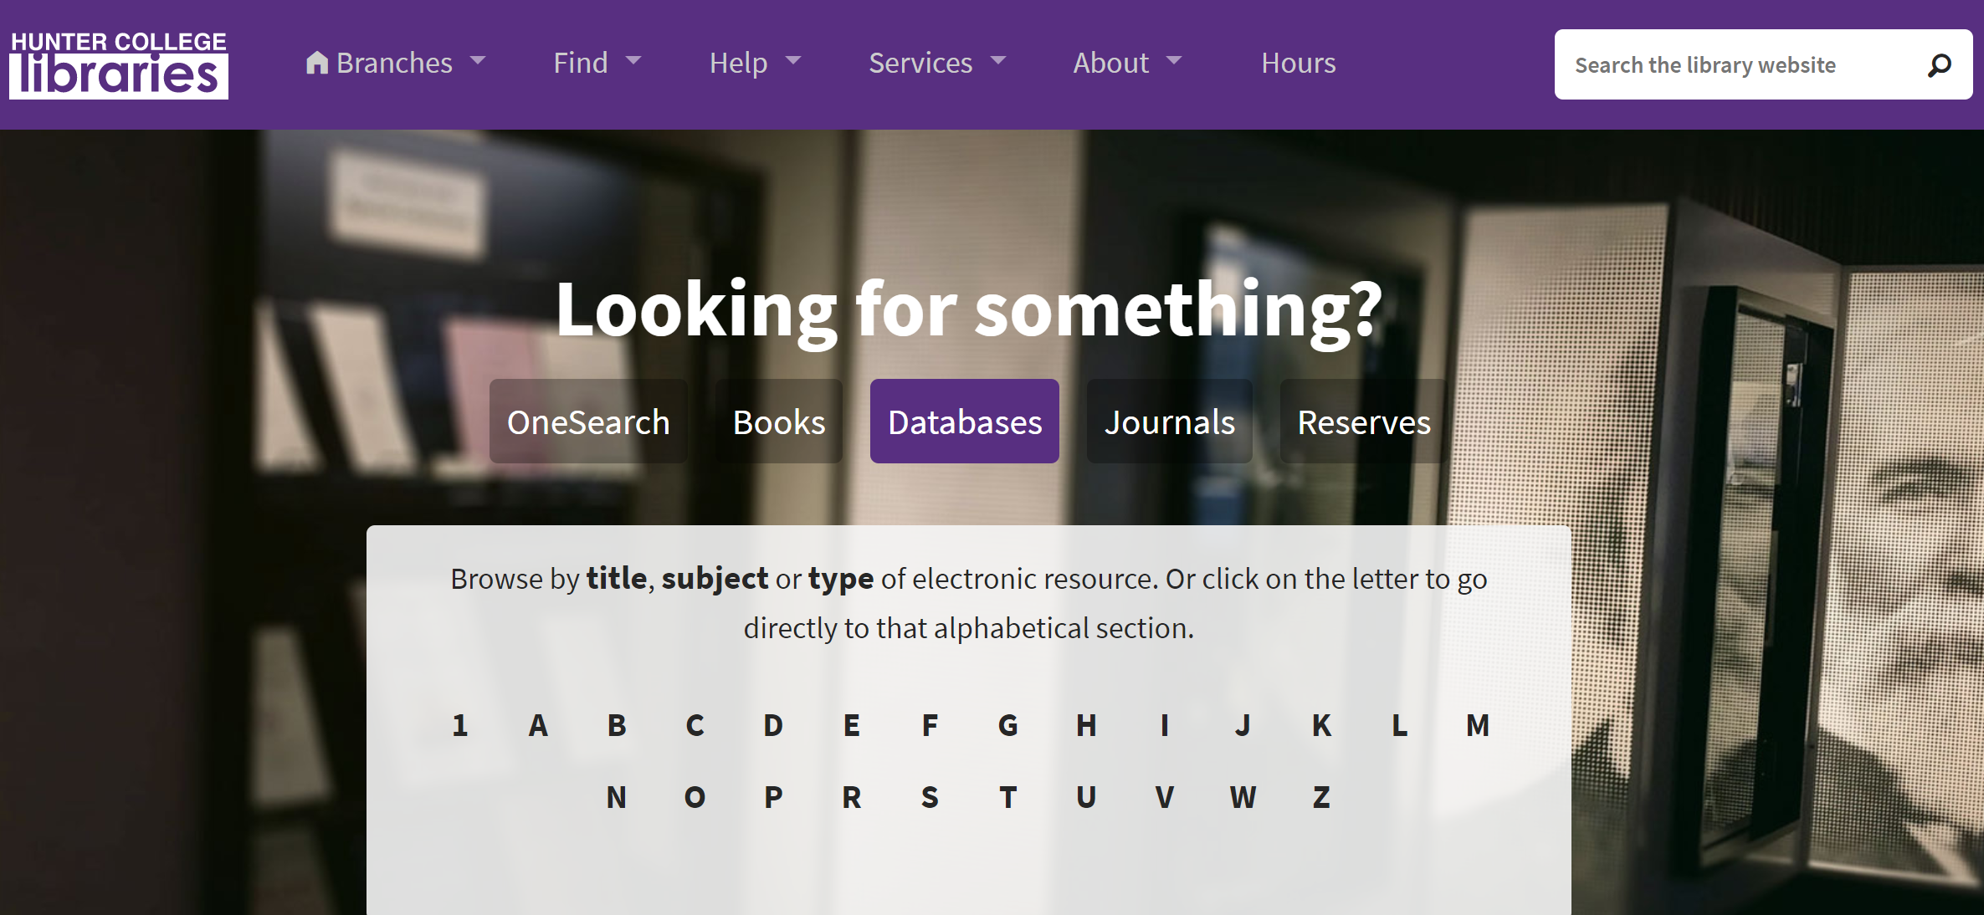
Ideas/Checklist For What To Discuss
A. Description of the Study
What was the purpose of the research?
Why is the research being conducted & why is it considered significant/important?
Were the research questions, objectives or hypothesis(es) clearly stated?
B. Literature Evaluation
Does the literature review seem thorough & recent (within the last 5 years)?
Does the content of the literature review relate directly to the research problem?
C. Conceptual Framework
Does the research use a theoretical or conceptual model?
Does the model guide the research and seem appropriate?
D. Sample
Who were the subjects?
Were the inclusion/exclusion criteria specified?
How representative is the sample?
Was there any selection bias evident in the sample selection?
E. Method and Design
Describe the study design – is it appropriate?
How was the research conducted (the study procedure itself) & data collected?
Were the subject’s rights protected?
F. Analysis
How were the data analyzed?
Do the selected statistical tests appear appropriate?
Were the results significant?
G. Results
What were the findings of the study?
Are the results presented in a clear and understandable way?
How did the authors interpret the results?
Were there any study limitations discussed?
H. Clinical Significance
What were the implications of this study to clinical nursing practice?
How does the study contribute to the body of knowledge?
Could the study be replicated?
What additional questions does the study raise?
Resources for Students Interested in Presenting
So many resources can be found here! But most importantly, free access to journals!
https://library.hunter.cuny.edu/

Slide 43
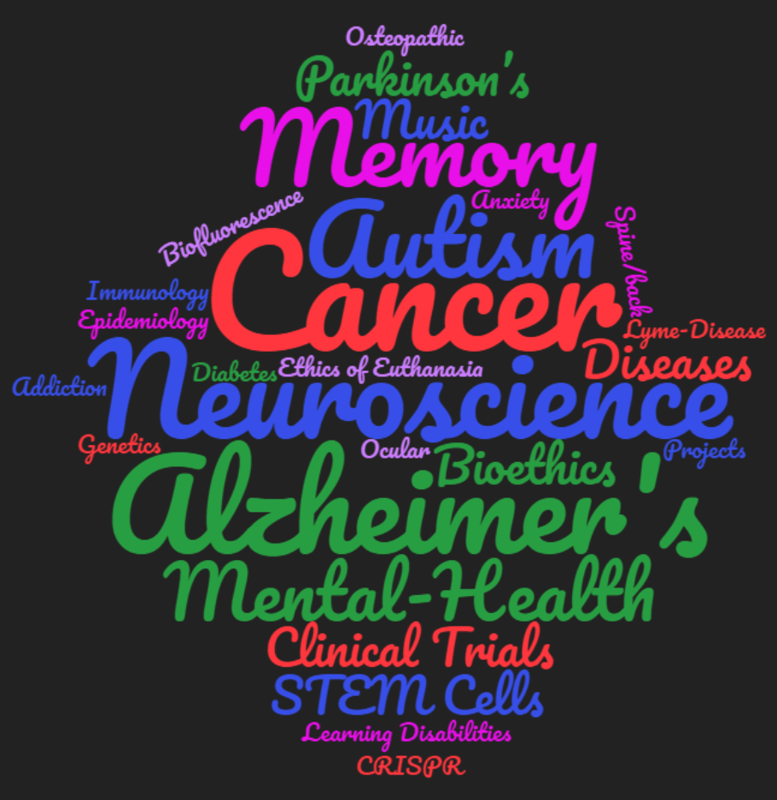
Topics Suggested By You!

Slide 44
Thank you for attending and participating!
For any questions, please email:
hunterjournalclub@gmail.com
@hunterjournalclub

